Slide 1
SEMINAR
ON
Deep Fake Video Detection Using Neural Network
Presented by
Pranay V. Shahare
&
Tejaswini V. Hirudkar
M.Sc. – (Computer Science) Semester-III
Under the Guidance of
Dr. S. R. Gedam
Assistant Professor
DEPARTMENT OF COMPUTER SCIENCE
Shri Shivaji Education Society Amravati’s,
SCIENCE COLLEGE
Congress Nagar, Nagpur-440012.
2020-21

Slide 2
Contents…
Introduction
Objective
Literature Survey
Methodology
Plan of Research
Implications
References

Slide 3
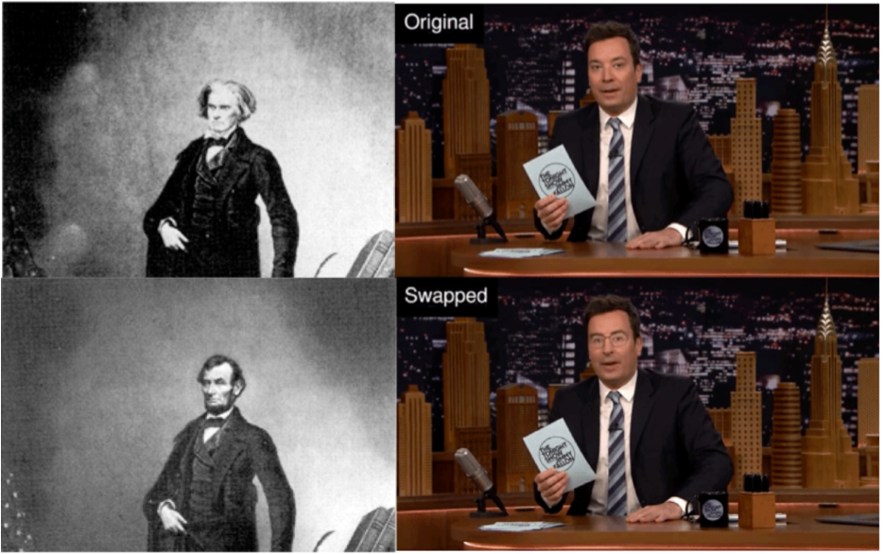
Introduction
The term “Deepfake” is a combination of two words “Deep Learning” and “Fake”. Deepfake are a type of algorithm based on deep learning and Artificial Intelligence which can harness fake videos and images. Deepfakes can be created by traditional visual effects or computer-graphics approaches.
It takes as input a video of a specific individual (’target’), and outputs another video with the target’s faces replaced with those of another individual (’source’). The backbone of DeepFake are deep neural networks trained on face images to automatically map the facial expressions of the source to the target.

Slide 4
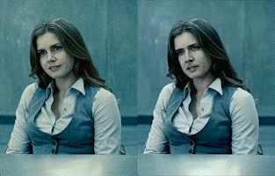
Objective
1. To create deepfake video using available applications (Zao, Deep Art, Wombo).
2. To detect a deepfake video using neural network.

Slide 5
Literature Survey
Abdul Jamsheed V., Janet B. , “Generative adversarial networks progressed to the point where it is very difficult to distinguish the difference between what is real or fake. In recent times, different face manipulating tools are used to generate credible face swaps in videos that leave a very little trace of manipulation, which is commonly referred as AI based Deep Fake videos”.
T. T. Nguyen and D. T. Nguyen, “We present extensive discussions on challenges, research trends and directions related to deepfake technologies. By reviewing the background of deepfakes and state-of-the-art deepfake detection methods, this study provides a comprehensive overview of deepfake techniques and facilitates the development of new and more robust methods to deal with the increasingly challenging deepfakes.”

Slide 6
Methodology
Deep Fake Creation
As deep fakes are spreading faster than expected and creating very serious issues; it’s necessary to have automatic tools and technologies to detect fake content.
Architecture
Dataset
Pre-Processing
CNN
The flow of methodology to be applied is:-
LSTM

Slide 7
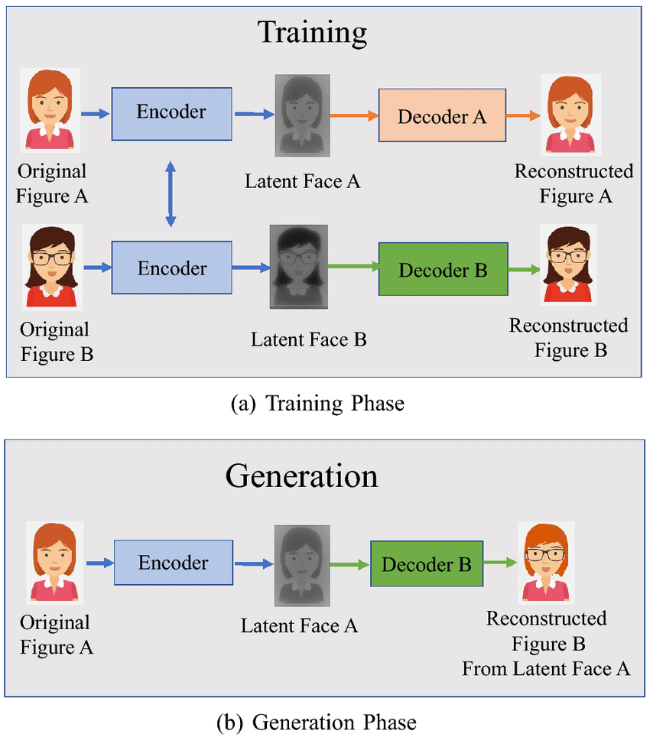
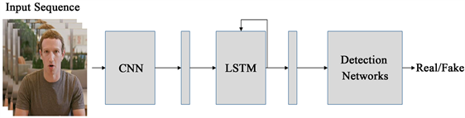

Slide 8
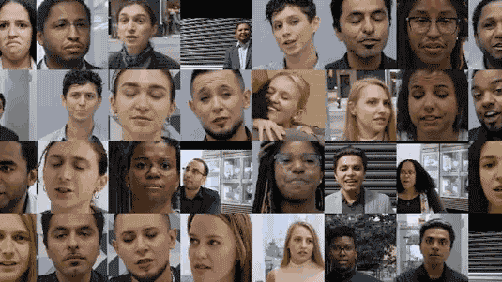
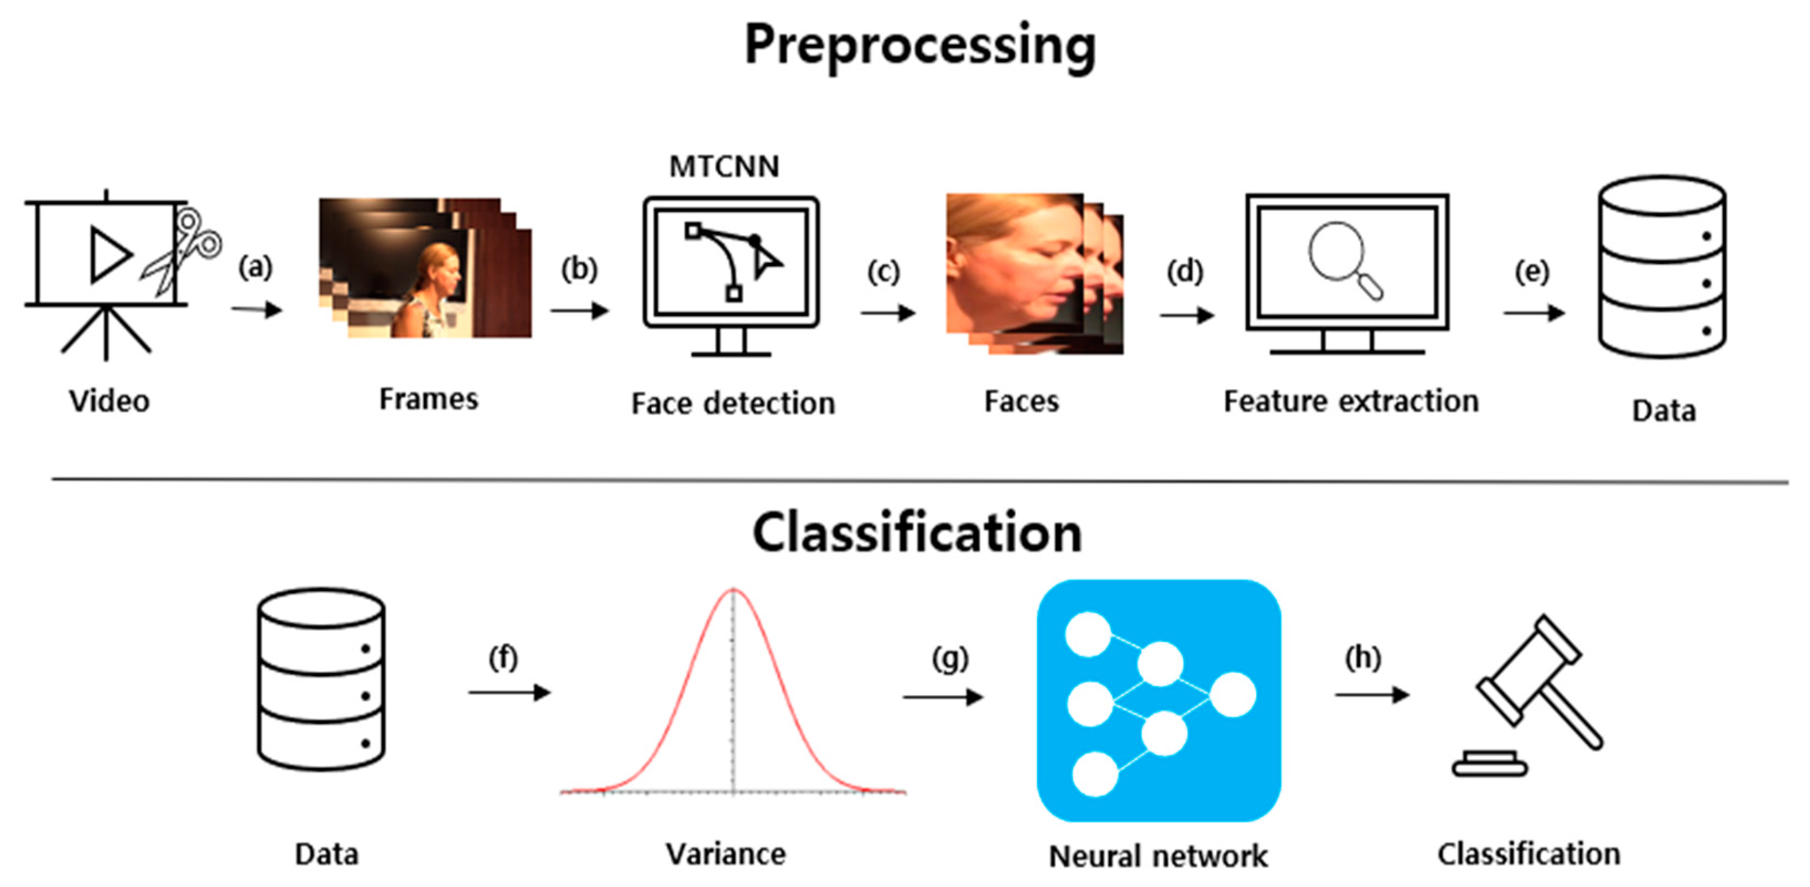

Slide 9
Plan of Research
1. Literature Survey.
2. Study of related work on deep fake video creation and detection techniques.
3. Study of methodology to solve the problem of deep fake video.
4. Perform the experiments to detect the deep fake videos using neural network technique.
5. Conclude the result of deep fake video detection using neural network.

Slide 10
Implications
We can represent a neural network based solution for detecting deep fake videos. This model is when trained using neural network can give quiet impressive results compared to other deep learning models. Creation of deep fake videos is a simple task but when it comes to the detection, it’s a major challenge. The advancement in creation of AI based deep fake videos has made the older detection system less accurate. But in this work, we can describe a new method which use deep learning based methodology to effectively detect manipulated or fake videos from real videos.

Slide 11
References
Anuj Badale, Chaitanya Darekar, Lionel Castelino, Joanne Gomes, “Deepfake Video Detection Using Neural Netwok”, International Journal of Engineering Research and Technology, ISSN: 2278-0181, NTASU 2020, (April 2021)
Yuezn Li, Siwei Lyu, “ Exposing Deepfake Videos By Detecting Face Warping Artifacts”, Institute of Electrical and Electronics Engineers, arXiv: 1811.00656v3 [cs.CV] (May 2019)
T.T. Nguyen, Q. V. H. nguyen, C. M. Nguyen, D. T. Nguyen, Saied Nahavandi, “ Deep Learning for Deepfakes creation and Detection”, Institute of Electrical and Electronics Engineers, arXiv: 1909.11573v3 [cs.CV] (April 2021)
Aarti Karandikar, Vedita Deshpande, Sanjana Singh, Sayali Nagbhidkar, Saurabh Agrawal, “ Deepfake Video Detection Using Convolutional Neural Network” , International Journal of Advanced trends in computer Science and Engineering, ISSN 2278-3091, Volume 9 No. 2 (April 2020)
Abdul Jamshhed V. Janet B. , “ Deep Fake Video detection Using Recurrent Neural Network” , International Journal of Scientific Research in Computer Science and Engineering, E-ISSN: 2320-7639, Volume 9, Issue:2 (April 2021)

Slide 12
Pavel Korshunov, Sebastien Marcel, “Deepfakes A New Threat to face recognition? Assessment And Detection” , arXiv:1812.08685v1 [cs.CV] (December 2020)
Akhil Sunil Kumar, Amruta Khavase, Himesh Rajendran, “ Deepfake Video Detection Using Neural Nnetwork”, International Journnal of Innovative research in technology, ISSN; 2349-6002, Volume 7, Issue 12, (May 2021)
Ruben t. Ruben Vera-Rodriguez, Julian Fierrez, Aythami Morales, Javier Ortega-Garcia, “ DeepFake and Beyond: A Survey of Face Manipulation and Fake Detection” , arXiv: 2001.00179v3 [cs.CV] (June 2020)
Deressa Wodajo, Solomon Atnafu, “ Deepfake Video detection Using Convolutional Vision Transformer”, Institute of Electrical and Electronics Engineering, arXiv: 2102.11126v3 [cs.CV] (March 2021)
Brian dalhansky, russ Howes, Ben Pflaum, Nicole Baram, Cristian Canton Ferrar, “ The Deepfake zdetection Challenge Preview Dataset” , Institute of Electrical and Electronics Engineering, arXiv: 1910.08854v2 [cs.CV] (23 October 2019)

Slide 13
THANK
YOU

